Slide 1

TECHNOLOGY BENCH
Crafting Technologies

Slide 2

ABOUT US:
1
Technology Bench is a leading IT solutions provider.
2
It helps businesses leverage technology to drive growth and achieve their goals.
3
A team of highly skilled professionals and a commitment to innovation,
4
We deliver cutting-edge solutions tailored to our clientsunique needs.

Slide 3
TALENT BOOST :
01
02
03
PHP LARAVEL
VUE JS
REACT
04
05
06
.NET
FLUTTER
JAVA

Slide 4
SERVICES
Custom Software
Artificial Intelligence
VR
Animations
Cloud Consulting
BlockChain
E-Commerce
IoT

Slide 5








OPEN SOURCE SERVICES :

Slide 6




OPEN SOURCE SERVICES :

Slide 7
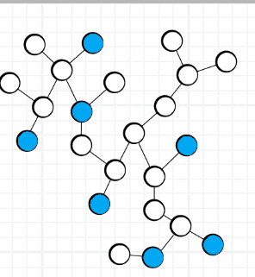
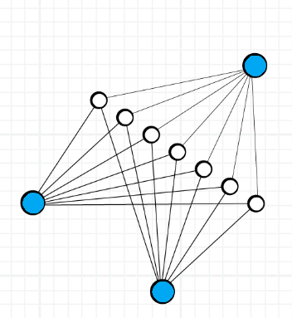
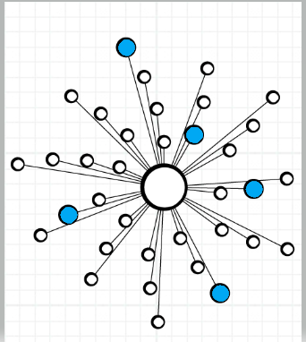
PROCESS:
→
DEFINE
DEVELOP
DEPLOY

Slide 8
INDUSTRY VERTICALS:
TRAVEL AND TOURISM
HEALTHCARE
FOCUS
AREAS
INFORMATION TECHNOLOGY
REAL ESTATE

Slide 9
FOCUS AREA:
EDUCATION
E-COMMERCE
FOCUS
AREAS
INTELIGENCE TRANSPORTATION SYSTEM
CLOUD SERVICES

Slide 10
Key Partners :
Leonardo
01

Slide 11

Key Partners :
Interloop
02

Slide 12
Key Partners :
Thales
03

Slide 13
Key Partners :
CGGC:
04

Slide 14

Key Partners :
WhyI:
05

Slide 15
Key Partners :
Speetar:
06

Slide 16
Key Partners :
Cosscut:
07

Slide 17

Key Partners :
Pakistan Civil Assosiation Authority :
08

Slide 18
Key Partners :
Dar-e-Sehat:
09

Slide 19
Key Partners :
Longhorn:
10

Slide 20

Key Partners :
Qureshi Brothers:
11

Slide 21

Key Partners :
Qureshi Brothers:
12

Slide 22

Key Partners :
Qureshi Brothers:
13

Slide 23

Key Partners :
Qureshi Brothers:
14

Slide 24

Key Partners :
Qureshi Brothers:
15

Slide 25
Key Partners :
Qureshi Brothers:
11

Slide 26





CONTACT US:
LINKED IN :
E-MAIL:
https://www.linkedin.com/
company/technology-bench/
Collaboration@tkbench.com
CALL OR WHATSAPP
WEBSITE:
+923105284584
www.tkbench.com

Slide 27


THANK YOU

